Slide 1
Neighbourhood Health and Care Programme
North Cumbria
VCSE Partnership Forum update
21st May 2026

Slide 2

Neighbourhood health is central to the government’s wider agenda of public service reform
Through Health and Wellbeing Boards, ICBs and local authorities will work in partnership to:
Plan for local populations
Address local priorities and health inequalities set out in their local joint strategic needs assessment
Agree how neighbourhood health can deliver additional benefits beyond those national minimum goals
Housing
Social Care,
Public Health
Pride in Place and regeneration
Family Hubs & Start in Life
Employment support
Special
Educational
Needs
Benefits and welfare
For neighbourhood health to be truly successful, services must join up across the full spectrum of public services that will impact people's ability to live a happy healthy life. This will include housing, employment, education and much, much more.
Health and Wellbeing Boards should build strong links between neighbourhood health and other reforms and consider opportunities for further integration of services. Local authority leaders will play a critical part of this
Examples of initiatives that local areas will wish to consider as part of their Neighbourhood Health Plans, and partners who will be involved
VCSE
ICBs
NHS providers
HWBs
Local authorities

Slide 3
Five core priorities for Neighbourhood Health
1) Improve health outcomes with a focus on high-priority cohorts
Helping people to stay healthier, manage escalating conditions and maintain greater independence for longer
Better identification of people coming to end of life and improved access to services
Better diagnosis and treatment for people with long-term condition
Improving quality and access to care for children and young people
2) Improve access to general practice
Making sure clinically urgent patients are seen on the same day
Faster access for routine GP care, improved patient satisfaction with access
3) Improve experience of planned care
Reduce variation in referrals to outpatient services
Better co-ordination of output activity
4) Better urgent and emergency care performance
Better coordination of reactive care for high priority cohorts
Reduce need for hospital admissions
Better coordination of discharge process and planning capacity
5) Improved patient and staff satisfaction with NHS services
Take a proactive approach, where patient fees in control of care
Ensure teams working within neighbourhoods feel more motivated in their work

Slide 4
The Framework outlines ten foundational steps for local areas to prioritise in 2026/27 to lay the groundwork
In 2026/27, ICBs and local authorities, working through their Health and Wellbeing Boards, should start developing and embedding new ways of working, to start jointly developing their approach to neighbourhood health services
Priorities for all partners
Priorities with a more specific ICB focus
Agree neighbourhood footprints
Agree plans to establish integrated neighbourhood teams
Increase urgent, rehabilitation and reablement services capacity
Confirm plans to spend pooled funding under the Better Care Fund
Confirm organisational ownership, governance and partnership arrangements to enable delivery
Confirm plans for having appropriate data-sharing arrangements in place
Agree a plan to improve GP access
Reform elective pathways for outpatients
Improving primary and secondary care interface
Confirm plans to cut community health services waiting lists – meeting 18-weeks and eliminating 52-weeks

Slide 5
For implementation from at least 2027/28, ICBs and local authorities should work with partners to develop a locally owned neighbourhood health plan
In The framework sets out what should be included in neighbourhood health plans
Set out how neighbourhood health will support wide local goals to improve health outcomes, reduce health inequalities, and deliver on locally agreed wider public service reforms
Set out how local objectives are informed by the joint strategic needs assessment and other relevant assessments
Outline how the national NHS objectives will begin to be delivered
Confirm final geographies partners will work within
Confirm how relevant initiatives align with the plan – such as Best Family Start Hubs, mental health hubs, Pride in Place and employment support
Confirm which organisations are responsible for each element of delivery
Confirm governance and operational partnership agreements
Systems can and should go beyond these measures, in line with what is right for their populations. Once the plan is agreed, it will be incorporated into the ICB’s refreshed 5-year strategic commissioning plan. This will be the formal NHS commissioning strategy for neighbourhood health
The success of neighbourhood health hinges on the heath and care system, local authorities and partners transforming how they work together by working collaboratively to agree a joint vision

Slide 6
Laying the groundwork
Established a Programme Team
Established a Programme Board
Neighbourhood health workshops

Slide 7
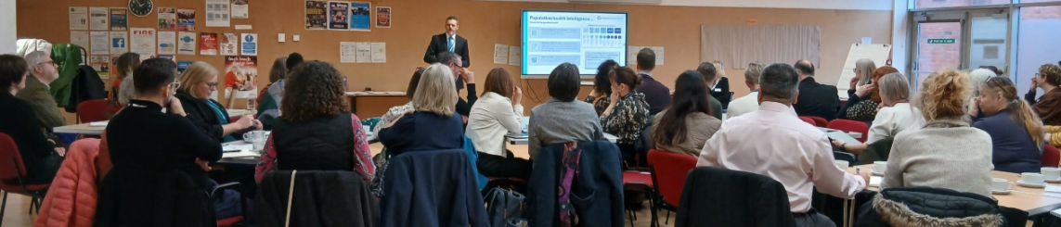
Neighbourhood Health Workshops update
Programme Scoping Workshops – 11th Feb 2026 & 21st April
February workshop
  Neighbourhood guidance to date
  Reviewed local data and current neighbourhood health maturity
  Breakout session to discuss priority areas of work and data needs
  Discussed immediate actions
April workshop
  Neighbourhood Health framework update
  Breakout discussion: what the framework means for North Cumbria
  Theme discussion: end of life partnership as a model for neighbourhood health
  Theme discussion: ICCs as a model for INTs
  Breakout discussion: ICC maturity

Slide 8
Laying the groundwork – work to date
Established a Programme Team
Established a Programme Board
Neighbourhood health workshops
Community Engagement Forum and news bulletin
Health and Wellbeing Board refresh
Agree plans to establish integrated neighbourhood teams
Confirm plans for having appropriate data-sharing arrangements in place
Partnership engagement

