Slide 1
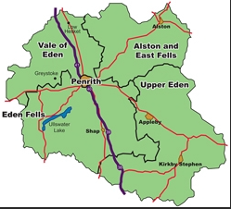
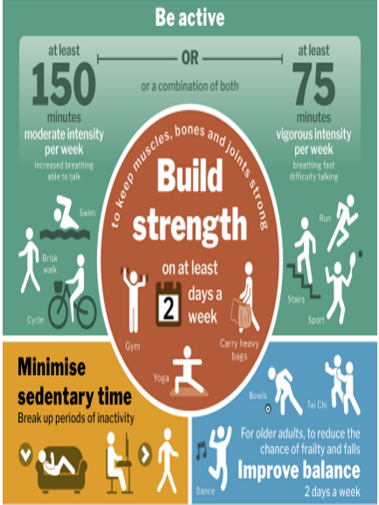
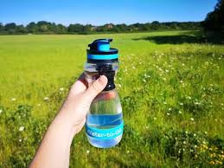
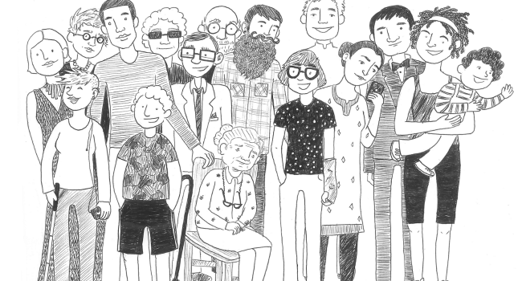
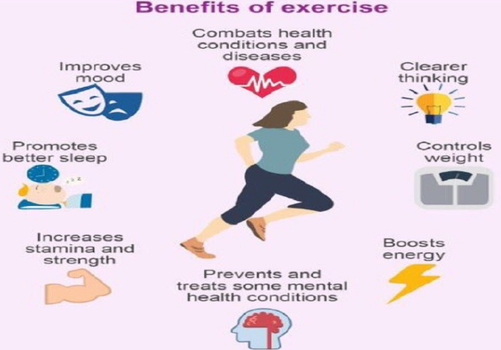





FIT4ALL
Join us for a variety of fun, friendly activities designed to help you stay active, healthy, and connected—right here in the Eden District or from the comfort of your own home.
Our classes are led by fully qualified instructors who understand a wide range of medical conditions and work closely with NHS community care teams, local GP practices and Westmorland and Furness council to support your wellbeing.
We aim to promote physical, social and mental well being through accessible exercises. Built on the 5S’ Stamina, strength, suppleness, skill and SMILES
Are you moving enough?
Promoting Physical activity and wellbeing throughout Eden
What to bring
Appropriate comfortable clothes/footwear
Bottle of water
Good vibes
£3 cash (£3.65 @Leisure Centres, no membership or booking needed)
New Timetable starting 8th September 2025
Mon | 11.00 Aquafit pool/swim session Appleby Leisure Centre 1hr | 1.00 Balance and Strength Walking Drills Frenchfield Pavilion outside 30min | 2.00 Mixed ability standing and seated (MA S+S) Lazonby Village hall 45min
Tues | 09.15 Zoom Online (Roo) | Email Roo below for Zoom code
Wed | 10.00 Exercise to music Frenchfield Pavilion outside 30 min | 11.15 Mixed ability standing and seated Glenridding village hall 45 min | 13.30 MA S+S Shap memorial hall 45min
Thurs | 9.15 MA S+S Supper Room Appleby Market Hall 45 min | 10.30 Aquafit pool/swim session Penrith leisure centre 1hr | 11.45 MA S+S Penrith Methodist church hall 45min
Benefits of Exercise
A Partnership Between
roobannister@outlook.com Westmorland and Furness Council
Rhiannon.douglas3@nhs.net 07507616033 Eden PCN

